Slide 1
Notes:
Girl fight
Iceland –Italy
Come to the stadium tomorrow and watch an exciting girlfight between the Icelandic Valkyries and the Italian girls in the preliminary round of the women world cup.
Meet the girls at Útilíf [Sports utility store] today between 16-17.
Laugardalur stadium at 11:00
Tomorrow september 8
Free entry. Everybody to the stadium. Go Iceland!
Source: Morgunblaðið, September 7, 2001.
https://timarit.is/files/7731278

Slide 2
Notes:
Girl fight
Iceland – Spain
They are back. More fierce than ever before since they must win tomorrow. The show starts at Laugardalur stadium at 18. Free entry. Everyone must show up.

Slide 3
Notes:
Ball War With Britain
Iceland – England Laugardalur stadium 16/9 at 17
This time it is not about cod but a spot at the 2003 World Cup. Now the entire nation must stand together. Iceland to the World Cup!

Slide 4
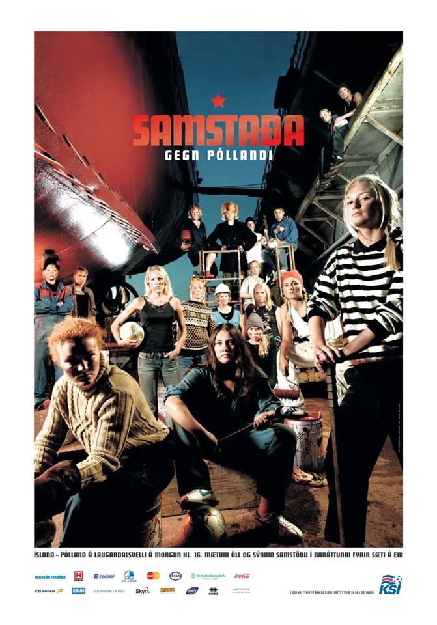
Notes:
Solidarity against Poland
Iceland – Poland at Laugardalur stadium tomorrow at 16. Come to the stadium and let´s show solidarity in the fight for a place at the European Championship.

Slide 5
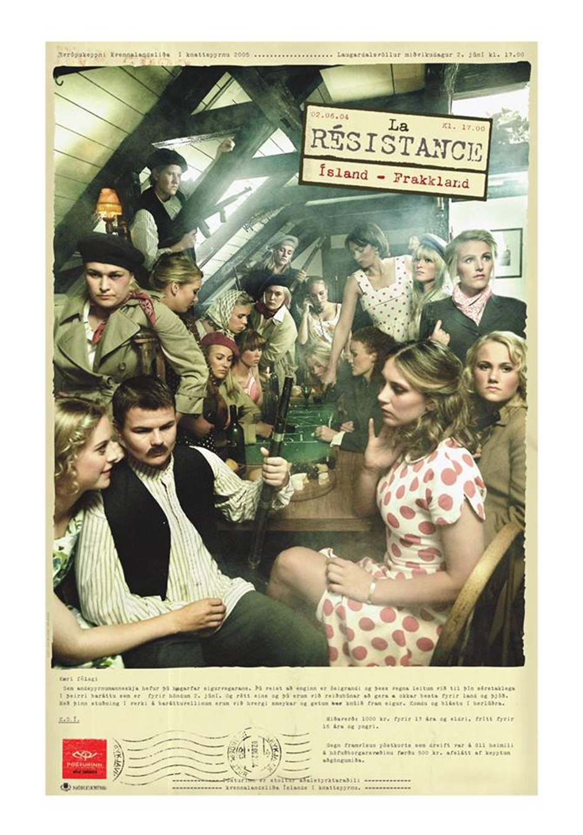
Notes:
European Women´s Football Championship 2005 ......... Laugardalur stadium Wednesday June 2 at 17.
La Résistance
Iceland – France
Dear Comrade,
As a resistance fighter you have the mentality of a winner. You know that no one is unbeatable and for that reason we seek your support in the coming struggle on June 7. And just like you we are ready to do our best for our country and nation. With your active support on the battlefield we are not afraid and victory will be ours. Come and make some noise.
Tickets are 1,000 Kr. Pr. adult. 17 years and younger enter free.

Slide 6
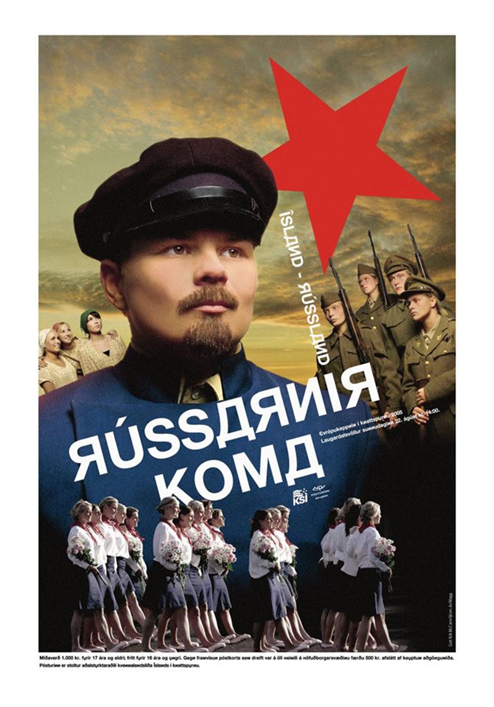
Notes:
Icelan – Russia
The Russians are coming
The European Championship 2005
Laugardalur stadium August 22 at 14:00.
Tickets are 1,000 Kr. for those who are 17 years and older. 16 year-olds and younger enter free. If you show a postcard that was sent to every home in the greater Reykjavik area you get a 500 Kr. discount.

Slide 7
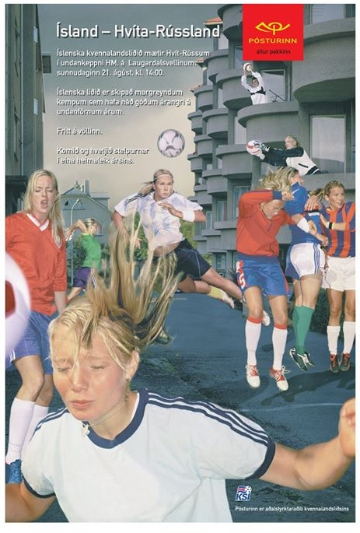
Notes:
Iceland – Belarus
The Icelandic national women´s team will play Belarus in the group stage of the World Cup at Laugardalur stadium on Sunday, August 21 at 14:00
The Icelandic team is full of experienced veterans and have had good results in the last few years.
Free entry
Come and support the girls in their only home game of the year.

Slide 8
